Slide 1


Lenka Belanova
29.5.2023

Slide 2

Outline
Executive Summary
Introduction
Methodology
Results
Conclusion
Appendix

Slide 3
Executive Summary
Summary of methodologies
Data collection using data wrangling
Data collection using API
Exploratory Data Analysis with SQL
Exploratory Data Analysis for Data Visualization
Interactive Visual Analytics with Folium
Interactive Dashboard with Plotly Dash
Predictive Analysis (Classification)
Summary of all results
EDA results
Insights from interactive visualizations
Predictive analysis results

Slide 4
Introduction
Project background and context:
SpaceX advertises Falcon 9 rocket launches on its website, with a cost of 62 million dollars; other providers cost upward of 165 million dollars each, much of the savings is because SpaceX can reuse the first stage. Therefore if we can determine if the first stage will land, we can determine the cost of a launch. The goal of this project is to create machine learning models to predict if first stage will land successfully or not.
Problems you want to find answers
What factors determined if first stage will land successfully?

Slide 5

Section 1

Slide 6
Methodology
Executive Summary
Data collection methodology:
SpaceX launch data was gathered from the SpaceX REST API
Perform data wrangling
Missing values were replaced with mean, Landing outcome was turned into categorical variable
Perform exploratory data analysis (EDA) using visualization and SQL
Perform interactive visual analytics using Folium and Plotly Dash
Perform predictive analysis using classification models
We found best parameters for our models and then calculated accuracy score for training and testing data to compare models among themselves

Slide 7
Data Collection
Collecting the Data with the SpaceX REST API
HTTP GET method performed to request the Falcon9 Launch HTML page, as an HTTP response (a list of JSON objects representing each launch).
Converting JSON to a Dataframe:
Using json_normalize() function to convert the JSON data into a Pandas dataframe.
Data Filtering and Dealing with Null Values in PayloadMass column
Falcon 1 launches were filtered out, the mean of the PayloadMass data was calculated and the null values were replaced with the mean
In addition, we performed web scraping related Wiki pages utilizing BeautifulSoup package. The scraped data were parsed and converted into Pandas

Slide 8
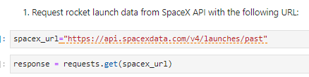
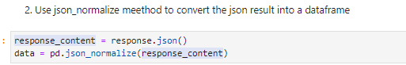
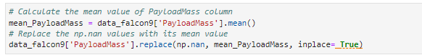
Data Collection – SpaceX API
Get request was used to the SpaceX API to collect data.
The requested data were cleaned, and then basic data wrangling and formatting were performed .
Link to the notebook:

Slide 9
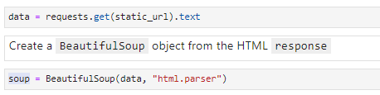
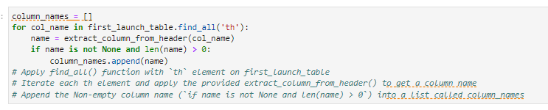
Data Collection - Scraping
Web scrapping was applied to obtain Falcon 9 launch records with BeautifulSoup
The scraped data were parsed and converted into Pandas
Link to the notebook:
Perform an HTTP GET method to request the Falcon9 Launch HTML page
Extract all column/variable names from the HTML table header
Create a data frame by parsing the launch HTML tables

Slide 10
Data Wrangling
The exploratory data analysis was performed, and the training labels were determined.
The number of launches at each site and the number and occurrence of each orbit were calculated.
The landing outcome label was created from the outcome column.
Link to the notebook:

Slide 11
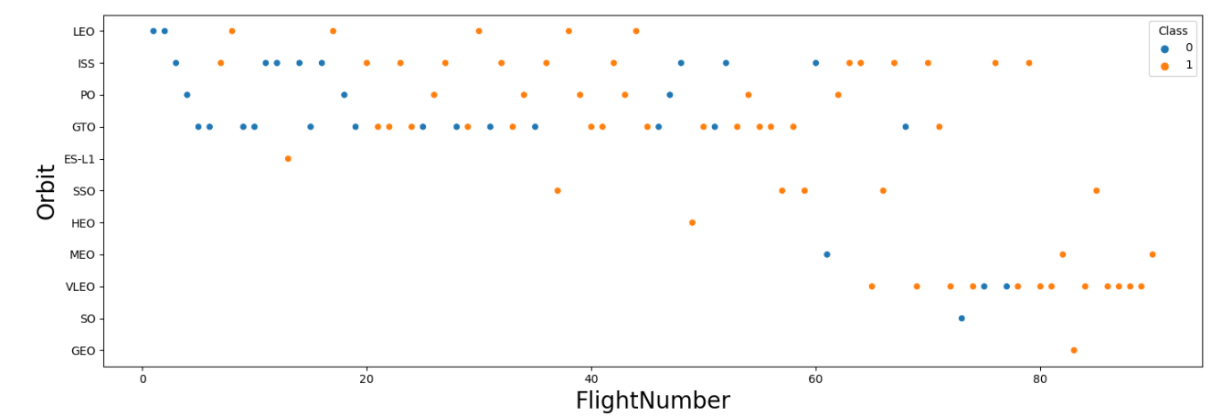
EDA with Data Visualization
We explored the data by visualizing the relationships between:
flight number and launch site
payload and launch site
success rate of each orbit type
flight number and orbit type
the launch success yearly trend
Link to the notebook:

Slide 12
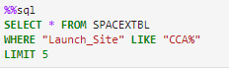
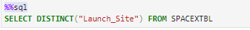
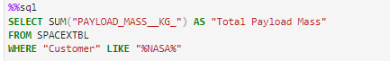
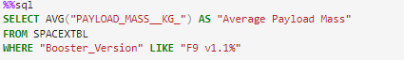
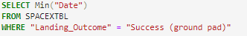
EDA with SQL
Following SQL queries were performed:
We displayed:
the names of the unique launch sites in the space mission :
5 records where launch sites begin with the string 'CCA’¶
the total payload mass carried by boosters launched by NASA (CRS)
average payload mass carried by booster version F9 v1.1
the date when the first succesful landing outcome in ground pad was achieved
the total number of successful and failure mission outcomes
the names of the boosters which have success in drone ship and have payload mass greater than 4000 but less than 6000
Link to the notebook:
Add the GitHub URL of your completed EDA with SQL notebook, as an external reference and peer-review purpose

Slide 13
Build an Interactive Map with Folium
All launch sites were marked on the folium map, and map objects such as markers, circles, and lines were added to indicate the success or failure of launches for each site.
The feature of launch outcomes (failure or success) was assigned to class 0 and 1, with 0 representing failure and 1 representing success.
By utilizing color-labeled marker clusters, launch sites with relatively high success rates were identified.
Distances between launch sites and their surrounding areas were calculated. Several questions were addressed, including:
Proximity to railways, highways, and coastlines.
Maintaining a certain distance from cities.
Link to the notebook:

Slide 14
Build a Dashboard with Plotly Dash
An interactive dashboard was constructed using Plotly Dash.
Pie charts were generated to display the total launches at specific sites.
Scatter graphs were plotted to visualize the relationship between Outcome and Payload Mass (Kg) for different booster versions.
Link to the notebook:

Slide 15
Predictive Analysis (Classification)
The data was loaded using numpy and pandas, followed by data transformation and splitting into training and testing sets.
Various machine learning models were constructed and hyperparameters were tuned using GridSearchCV.
The accuracy metric was utilized to assess the model's performance, and improvements were made through feature engineering and algorithm tuning.
It was determined that all models exhibited comparable levels of accuracy.
Link to the notebook:

Slide 16
Results
Exploratory data analysis results
Interactive analytics demo in screenshots
Predictive analysis results

Slide 17

Section 2

Slide 18
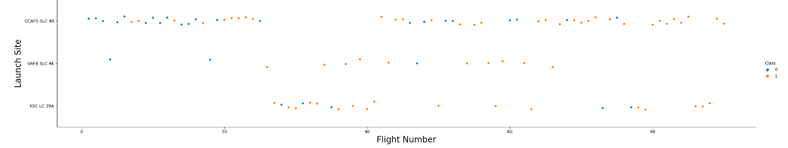
Flight Number vs. Launch Site
We see that as the flight number increases, the first stage is more likely to land successfully

Slide 19
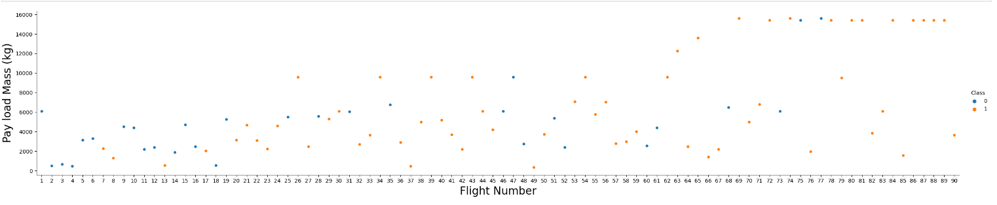
Payload vs. Launch Site
We see that as the flight number increases, the first stage is more likely to land successfully. The payload mass is also important; it seems the more massive the payload, the less likely the first stage will return.

Slide 20
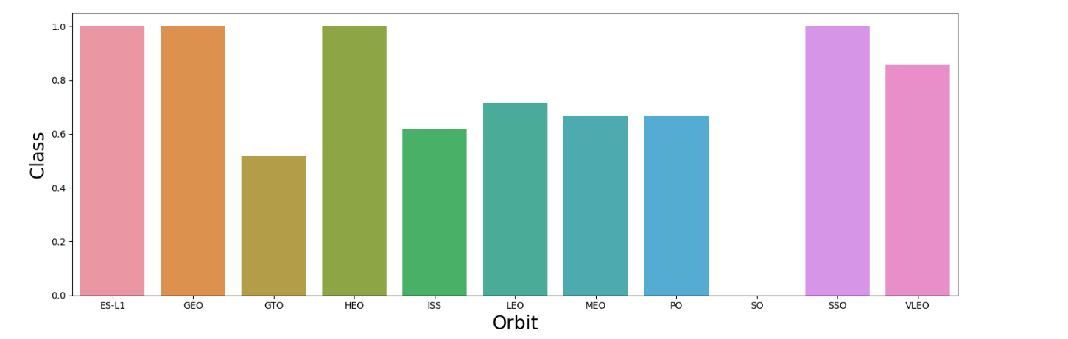
Success Rate vs. Orbit Type
We see that orbits, that have high sucess rate are ES-L1, GEO, HEO, SSO.

Slide 21
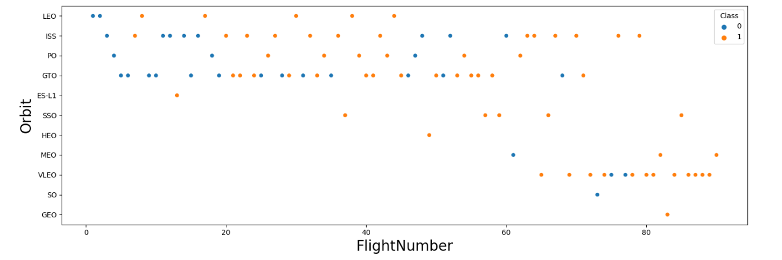
Flight Number vs. Orbit Type
We see that in the LEO (Low Earth Orbit), success appears to be correlated with the number of flights. However, in the GTO (Geostationary Transfer Orbit), there seems to be no discernible relationship between the flight number and the orbit.

Slide 22
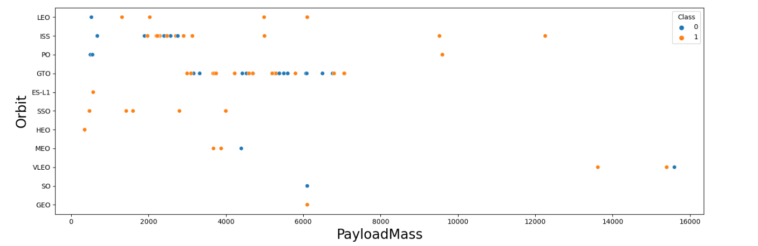
Payload vs. Orbit Type
With heavy payloads the successful landing or positive landing rate are more for Polar,LEO and ISS. However for GTO we cannot distinguish this well as both positive landing rate and negative landing(unsuccessful mission) are both there here.

Slide 23
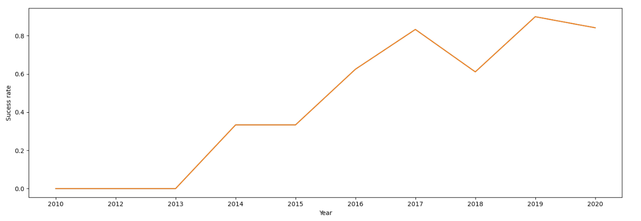
Launch Success Yearly Trend
We can see that the success rate since 2013 kept increasing till 2020

Slide 24
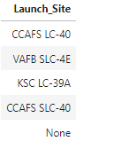
All Launch Site Names
Distinct function was used to find all unique launch sites.
Query:
Result:

Slide 25
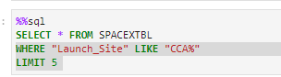
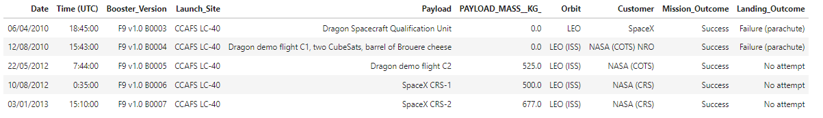
Launch Site Names Begin with 'CCA'
To find 5 records where launch sites begin with `CCA` following condition was used:
WHERE "Launch_Site" LIKE "CCA%"
LIMIT 5
Query:
Result:

Slide 26
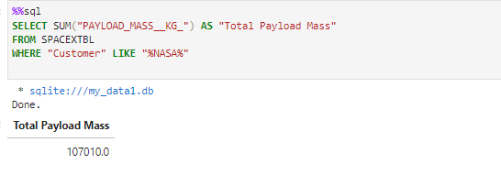
Total Payload Mass
To calculate the total payload carried by boosters from NASA, condition WHERE "Customer" LIKE "%NASA%“ was used and aggregation function SUM() on payload mass

Slide 27
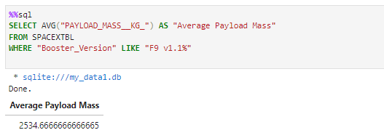
Average Payload Mass by F9 v1.1
TO caalculate the average payload mass carried by booster version F9 v1.1 , condition WHERE "Booster_Version" LIKE "F9 v1.1%" was used and aggregation function AVG() on payload mass

Slide 28
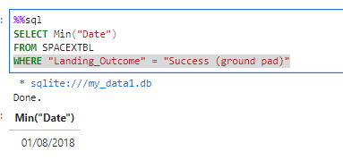
First Successful Ground Landing Date
To find the dates of the first successful landing outcome on ground pad condition WHERE "Landing_Outcome" = "Success (ground pad)“ was used and function MIN() on variable “Date”

Slide 29
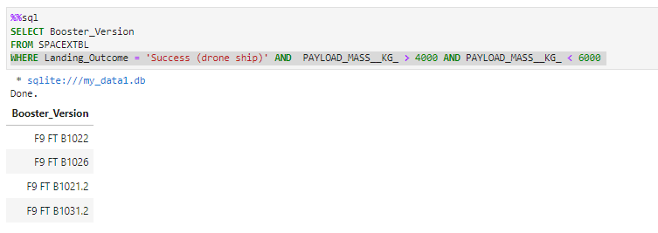
Successful Drone Ship Landing with Payload between 4000 and 6000
To list the names of boosters which have successfully landed on drone ship and had payload mass greater than 4000 but less than 6000, condition: WHERE Landing_Outcome = 'Success (drone ship)' AND PAYLOAD_MASS__KG_ > 4000 AND PAYLOAD_MASS__KG_ < 6000 was used.

Slide 30
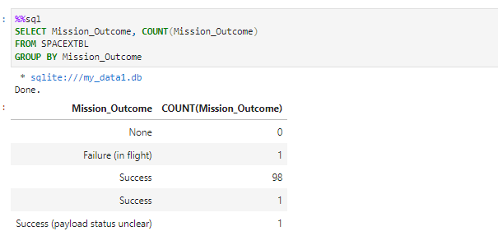
Total Number of Successful and Failure Mission Outcomes
To calculate the total number of successful and failure mission outcome, data was group by Mission_Outcome and count function was used.

Slide 31
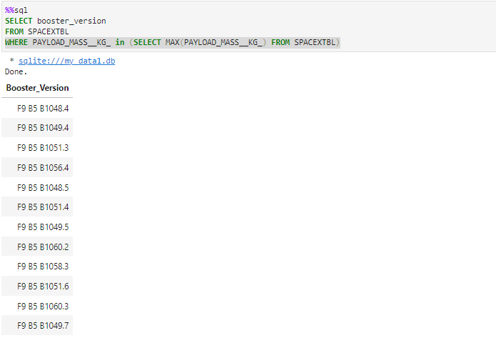
Boosters Carried Maximum Payload
To list the names of the booster which have carried the maximum payload mass condition WHERE PAYLOAD_MASS__KG_ in (SELECT MAX(PAYLOAD_MASS__KG_) FROM SPACEXTBL) with subquery was used.

Slide 32
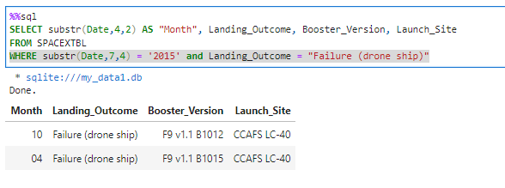
2015 Launch Records
To list the failed landing_outcomes in drone ship, their booster versions, and launch site names for in year 2015, condition WHERE substr(Date,7,4) = '2015' and Landing_Outcome = "Failure (drone ship)“ was used.

Slide 33
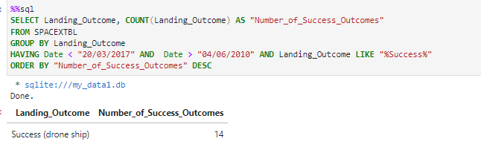
Rank Landing Outcomes Between 2010-06-04 and 2017-03-20
TO rank the count of landing outcomes (such as Failure (drone ship) or Success (ground pad)) between the date 2010-06-04 and 2017-03-20, in descending order we group data by Landing_outcome, using condition in HAVING and then ordered data.

Slide 34

Section 3

Slide 35
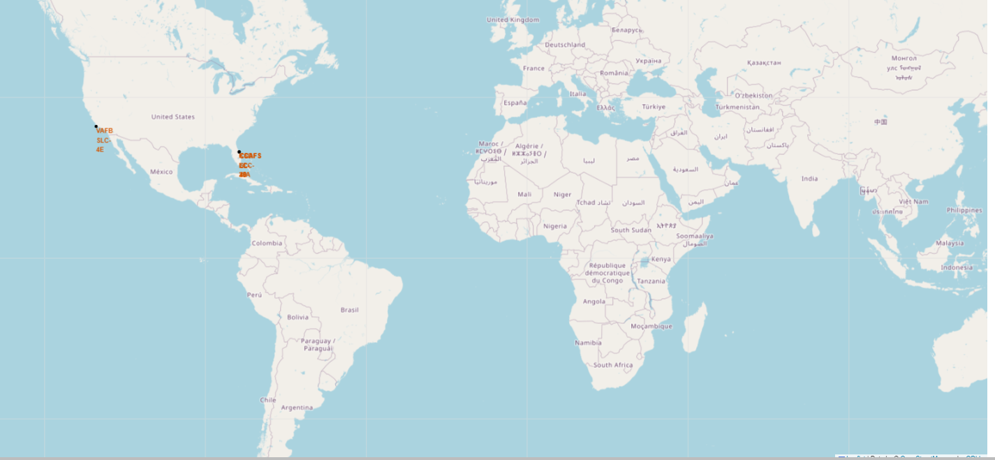
All launch sites global map markers
All SpaceX
launch sites
are in USA
(west and east coast).

Slide 36
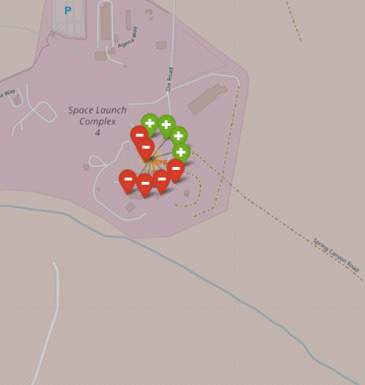
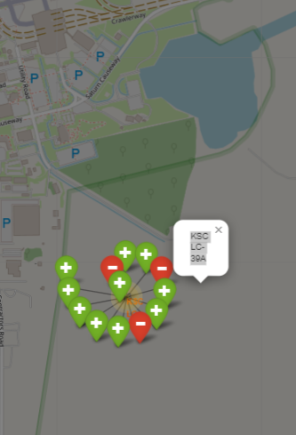
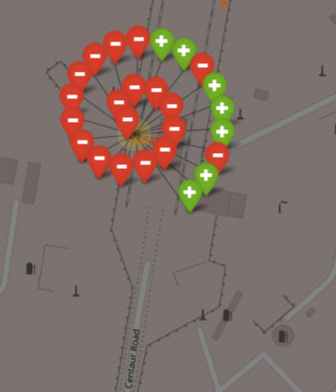
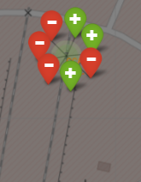
The success/failed launches for each site
VAFB SLC-4E
CCAF SLC-40
KSC LC-39A
CCAFS LC-40
Green markers indicate successful launches and red markers indicate failure.

Slide 37
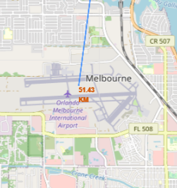
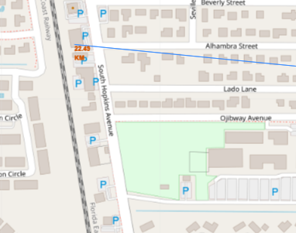
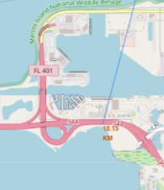
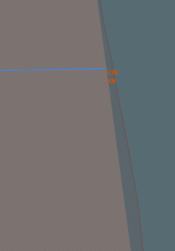

Launch site distance to landmarks
launch site to its closest:
city railway highway coastline

Slide 38

Section 4

Slide 39
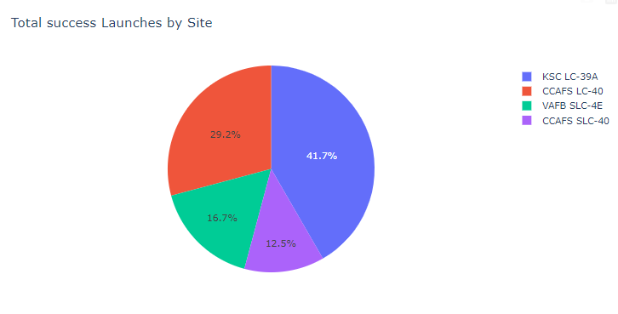
Total success Launches by Site
We can see that KSC LC-39A has the highest number of successful launches compared to all other launch sites. Conversely, CCAFS LC-40 has the lowest number of successful launches.

Slide 40
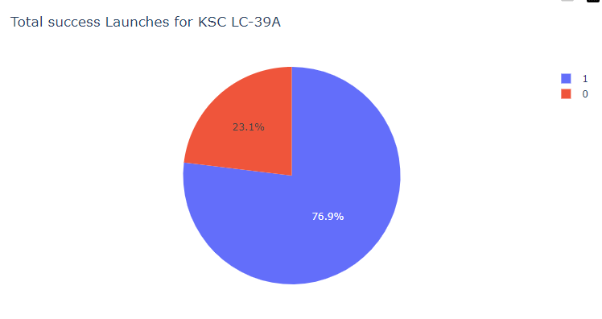
The Launch Site with the Highest Success Rate
76.9% of Launches from KSC LC-39A were successful.

Slide 41
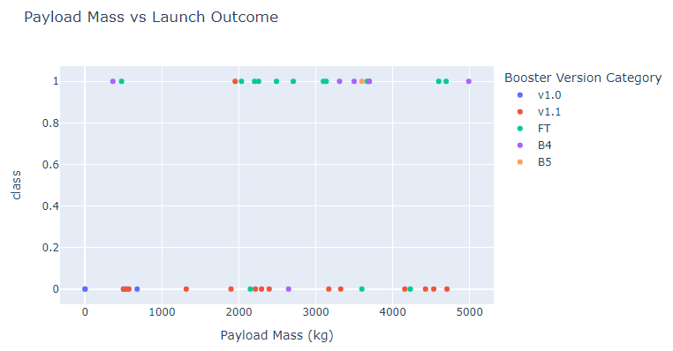
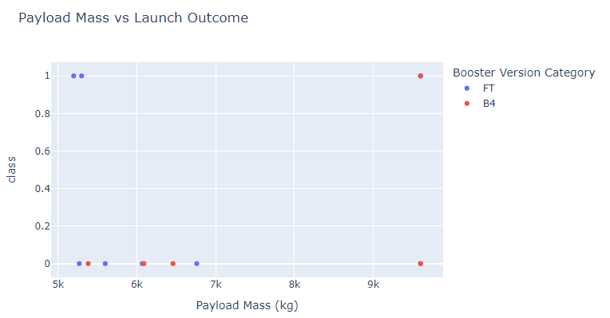
Payload vs. Launch Outcome scatter plot for all sites
Payload range < 5000
Payload range > 5000

Slide 42

Section 5

Slide 43
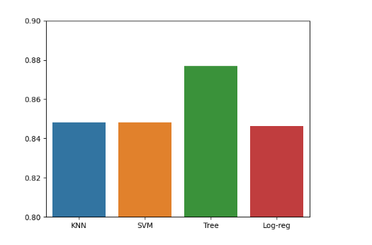
Classification Accuracy
Model with highest accuracy is Decision-Tree model. Accuracy is: 0.8768

Slide 44
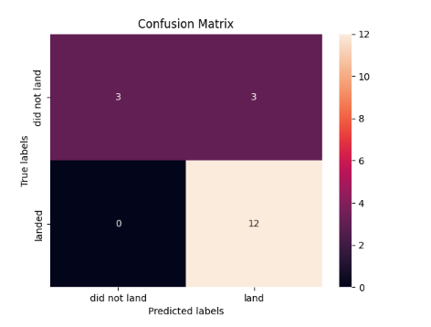
Confusion Matrix
The confusion matrix of the decision tree classifier indicates its ability to differentiate between different classes. However, a notable concern arises with false positives, where the classifier incorrectly labels unsuccessful landings as successful landings.

Slide 45
Conclusions
Key conclusions:
More flights at a launch site correspond to higher success rates.
Launch success rates have improved from 2013 to 2020.
Orbits like ES-L1, GEO, HEO, SSO, and VLEO have the highest success rates.
KSC LC-39A has the most successful launches among all sites.
The Decision Tree Classifier is the best algorithm for this task.

Slide 46
Appendix
Include any relevant assets like Python code snippets, SQL queries, charts, Notebook outputs, or data sets that you may have created during this project

Slide 47


